Slide 1
Library Management System using SQL
By Maira Nawaz

Slide 2
Project Overview
Project Title: Library Management System
Objective:
Implement a structured database for library management
Perform CRUD operations
Execute advanced SQL queries for analysis

Slide 3
Project Objectives
Database Setup – Creating and populating tables
CRUD Operations – Insert, Read, Update, Delete
CTAS (Create Table As Select) – Generate new tables based on queries
Advanced SQL Queries – Perform data analysis and reporting

Slide 4

Database Schema & ERD
Tables Created:
Branches
Employees
Members
Books
Issued Status
Return Status
Relationships & Foreign Keys
Employees linked to Branches
Issued books linked to Members & Employees
Returned books linked to Issued Status

Slide 5
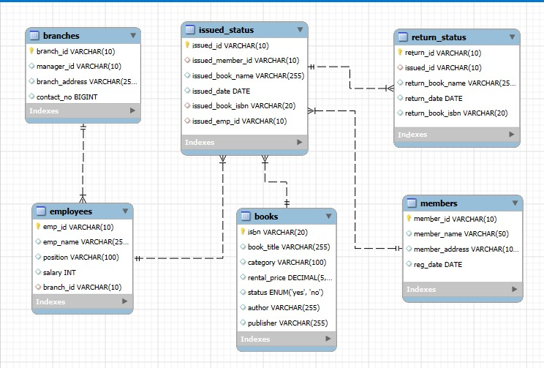
ERD Diagram

Slide 6

Database Setup - SQL Commands
Database Creation:

Slide 7
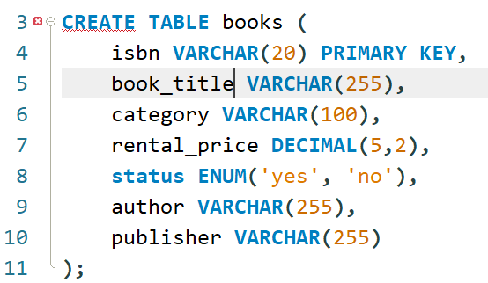
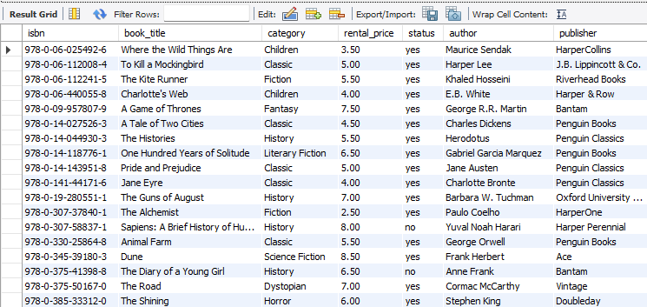
Creating books table

Slide 8
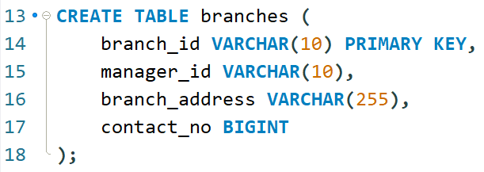
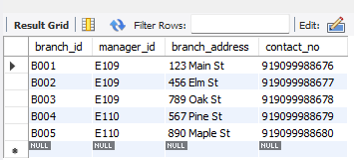
Creating branches table

Slide 9
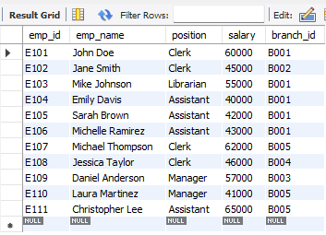
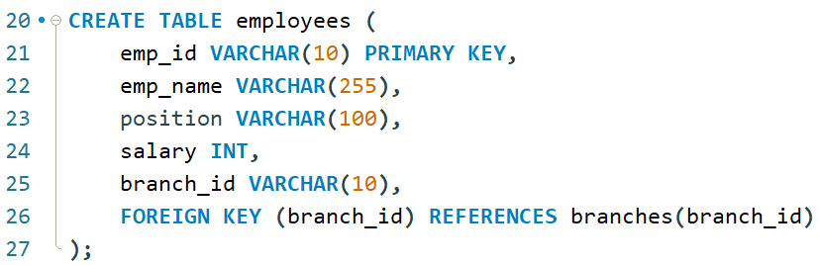
Creating employees table

Slide 10
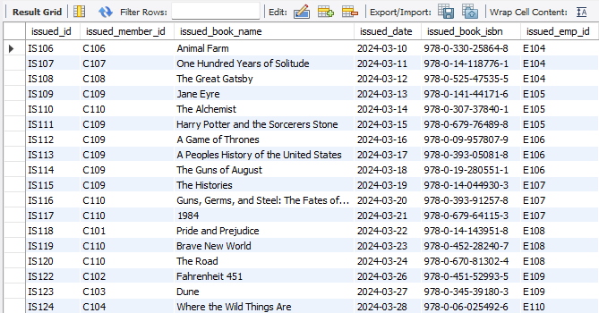
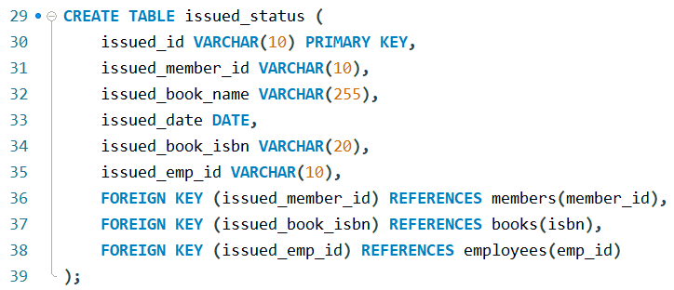
Creating issued_status table

Slide 11
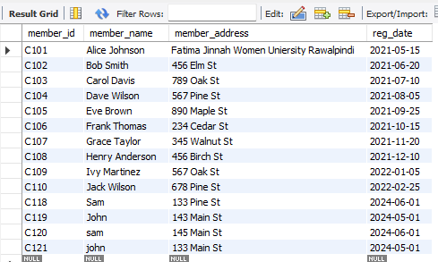
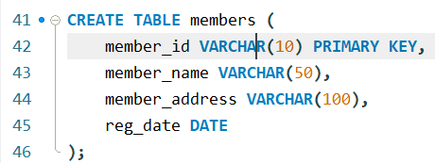
Creating members table

Slide 12
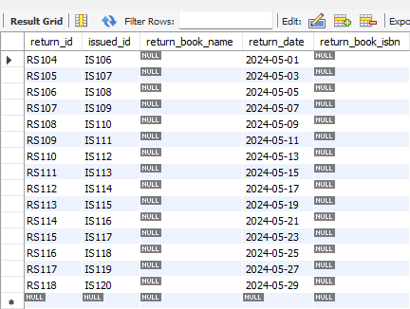
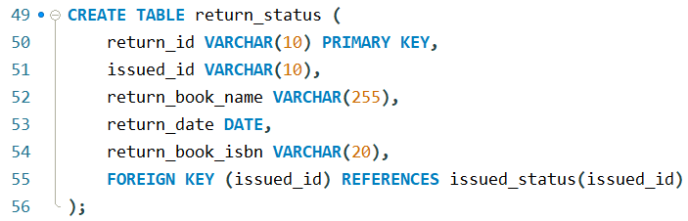
Creating return_status table

Slide 13
Project Task
2. CRUD Operations
Task 1. Create a New Book Record-- "978-1-60129-456-2', 'To Kill a Mockingbird', 'Classic', 6.00, 'yes', 'Harper Lee', 'J.B. Lippincott & Co.’)”
Task 2: Update an Existing Member's Address
Task 3: Delete a Record from the Issued Status Table-- Objective: Delete the record with issued_id = 'IS104' from the issued_status table
Task 4: Retrieve All Books Issued by a Specific Employee-- Objective: Select all books issued by the employee with emp_id = 'E101’.
Task 5: List Members Who Have Issued More Than One Book-- Objective: Use GROUP BY to find members who have issued more than one book.
3. CTAS (Create Table As Select)
Task 6: Create Summary Tables**: Used CTAS to generate new tables based on query results - each book and total book_issued_cnt
4. Data Analysis & Findings
Task 7. **Retrieve All Books in a Specific Category:
Task 8: Find Total Rental Income by Category:
Task 9. **List Members Who Registered in the Last 180 Days**:
Task 10: List Employees with Their Branch Manager's Name and their branch details
Task 11. Create a Table of Books with Rental Price Above a Certain Threshold
Task 12: Retrieve the List of Books Not Yet Returned

Slide 14
2. CRUD Operations
CRUD Operations
1. CREATE (Insert Data)
Adds new records to a table.
Used to store new books, users, or transactions in the database.
2. READ (Retrieve Data)
Fetches data from the database without modifying it.
Used to search for books, check availability, or view user details.
3. UPDATE (Modify Data)
Changes existing records in a table.
Used to update book availability, modify user details, or edit rental prices.
4. DELETE (Remove Data)
Deletes records from a table permanently.
Used to remove outdated books, delete user accounts, or erase old transactions.
Would you like this formatted into PowerPoint slides? 😊

Slide 15
Task 1:
Create a New Book Record-- "978-1-60129-456-2', 'To Kill a Mockingbird', 'Classic', 6.00, 'yes', 'Harper Lee', 'J.B. Lippincott & Co.’)”

Slide 16

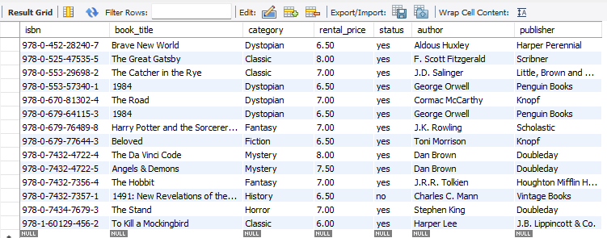
Task 1:
New record is added in books table:

Slide 17
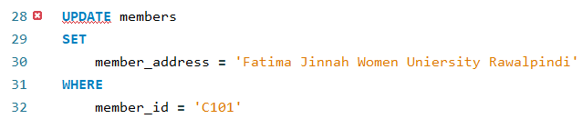
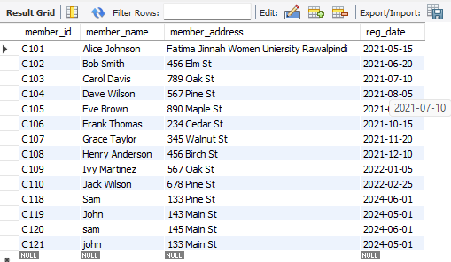
Task 2:
Update an Existing Member's Address:

Slide 18

Task 3:
Delete a Record from the Issued Status Table:

Slide 19
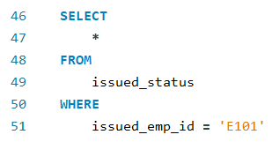

Task 4:
Retrieve All Books Issued by a Specific Employee

Slide 20
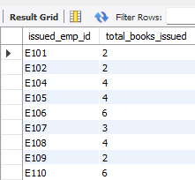
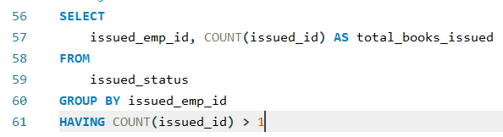
Task 5:
List Members Who Have Issued More Than One Book:

Slide 21
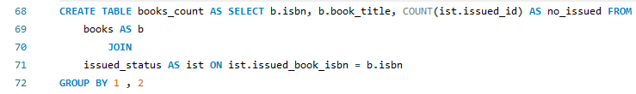
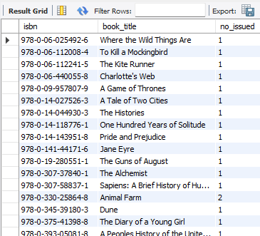

3. CTAS (Create Table As Select)
Task 6: Create Summary Tables : Used CTAS to generate new tables based on query results - each book and total book_issued_cnt

Slide 22
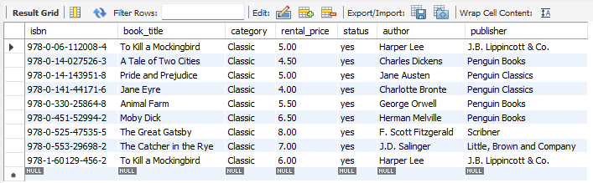
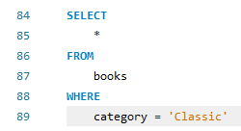
4. Data Analysis & Findings
Task 7. Retrieve All Books in a Specific Category:

Slide 23
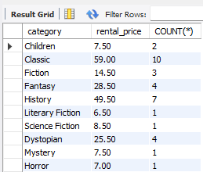
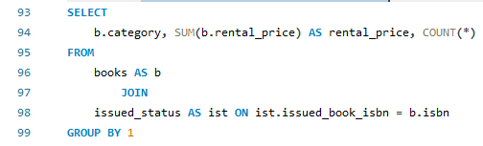
Task 8:
Find Total Rental Income by Category:

Slide 24
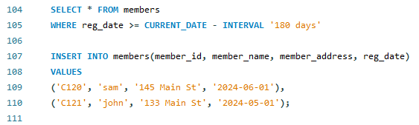
Task 9:
List Members Who Registered in the Last 180 Days:

Slide 25
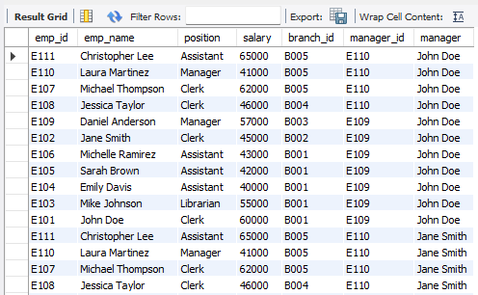
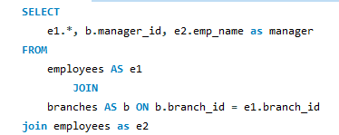
Task 10:
List Employees with Their Branch Manager's Name and their branch details**:

Slide 26

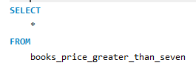
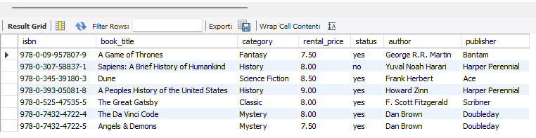
Task 11:
Create a Table of Books with Rental Price Above a Certain Threshold

Slide 27
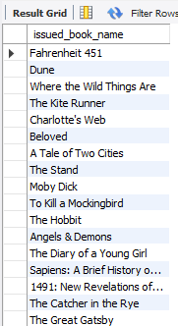
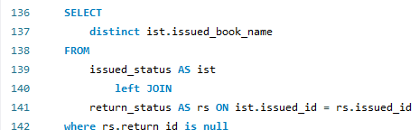
Task 12:
Retrieve the List of Books Not Yet Returned

